Slide 1


CORRELATED MAGNETICS
Accelerate the scientific method with agile design of advanced magnetics
By: Tim Costello
Notes:
10-minute version: about 20 seconds here; aim to be done by 0:20.
Open with the promise in one sentence: today I will show how agile design of advanced magnetics collapses the design-build-test loop for multipole magnets from weeks to under a day, at the precision of the manufacturing process. Ten seconds on who you are, then move.

Slide 2
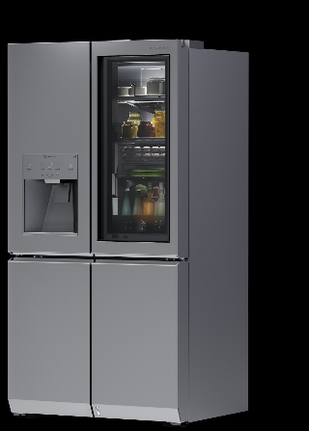
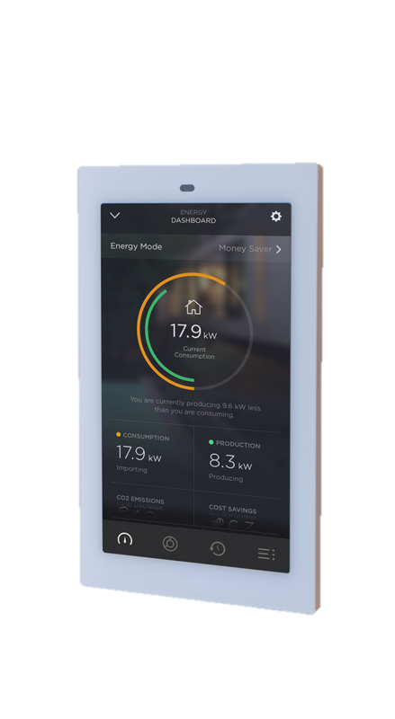
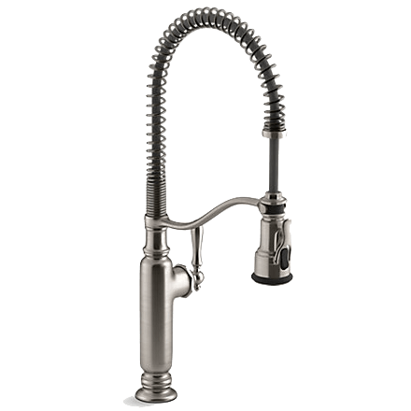
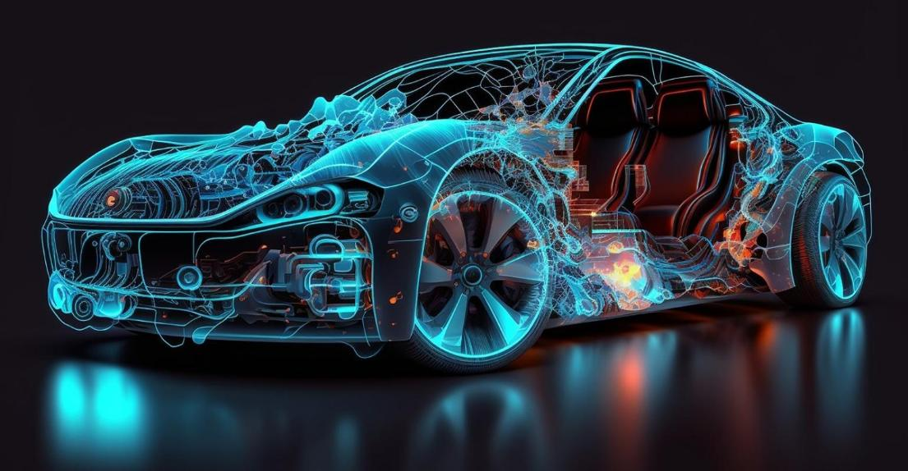
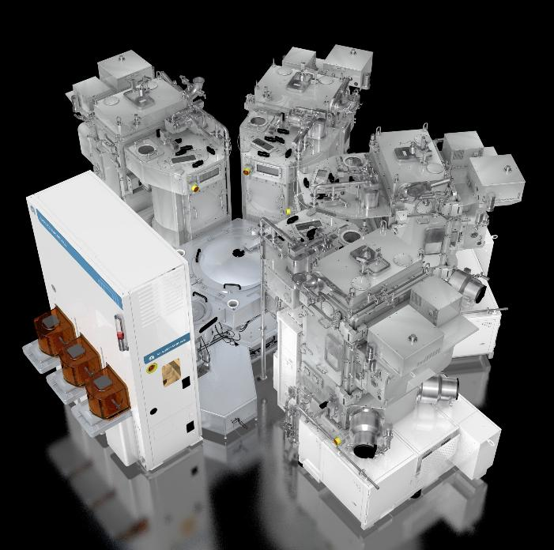


My Perspective and Experience
®
CORRELATED MAGNETICS
Notes:
Thirty seconds of credibility: why I have lived this problem and why it matters to a magnetics audience.

Slide 3
The Designer's Dilemma: The Tyranny of the Or
The knowledge is not well distributed
By nature, we often lack off the shelf components
We lack the advanced design software needed to create the functionality
Prototyping is imprecise, expensive and time consuming
We settle for close enough, or abandon a differentiating and effective design
Bad Quality
Low Cost
Fast
Objective
Slow
Expensive
High Quality
®
CORRELATED MAGNETICS
Notes:
10-minute version: about 45 seconds here; aim to be done by 1:05.
The constraint triangle: fast, cheap, good, pick two. In advanced magnetics the 'or' has been unusually tyrannical for four concrete reasons: the knowledge is not well distributed, there are few off-the-shelf components, the design software to create the functionality is missing, and prototyping is imprecise, expensive and slow. So teams settle for close-enough or abandon a differentiating design. That is the problem we remove.

Slide 4



Head Designer – Managing Director
Notes:
Set the standard: a head designer who relentlessly asks 'is this good enough, is it right?' Hold that bar for magnetics instead of accepting the compromise.

Slide 5




“Yes, he had a surgically precise opinion, Yes, it could sting. Yes, he constantly questioned “is this good enough? Is it right?“ But he was so clever. His ideas were bold and magnificent. They could suck the air from the room”
Jony Ive
Notes:
The Jony Ive standard, then the payload: advanced magnetics inside, controlling feel and haptics, precision, function, alignment, material reduction, footprint reduction, field control, and safety. Each is a design variable once magnetization can be placed precisely.

Slide 6
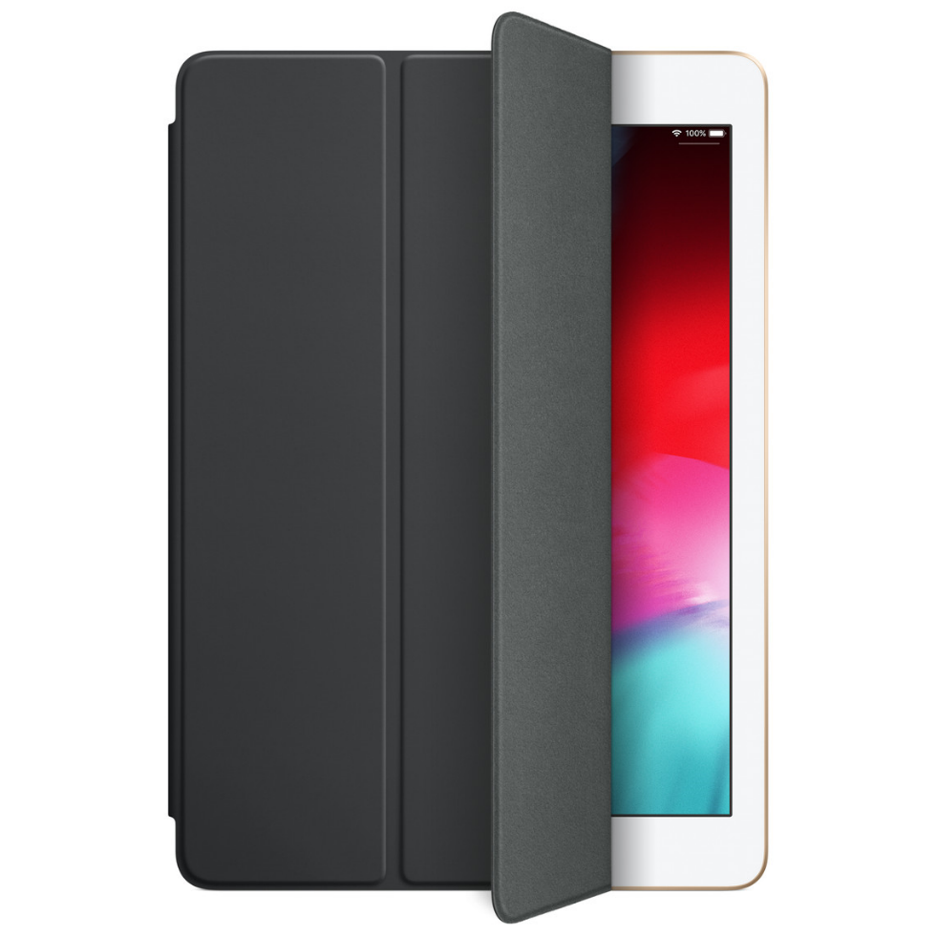

Advanced magnetics inside
Feel/UX/Haptic Design
Precision
Function
Alignment
Material Reduction
Footprint Reduction
Field Control
Safety…..
®
CORRELATED MAGNETICS
Notes:
Expand the 'advanced magnetics inside' idea: haptics, alignment, field control all become design variables. Hold this thought; the demo proves it.

Slide 7
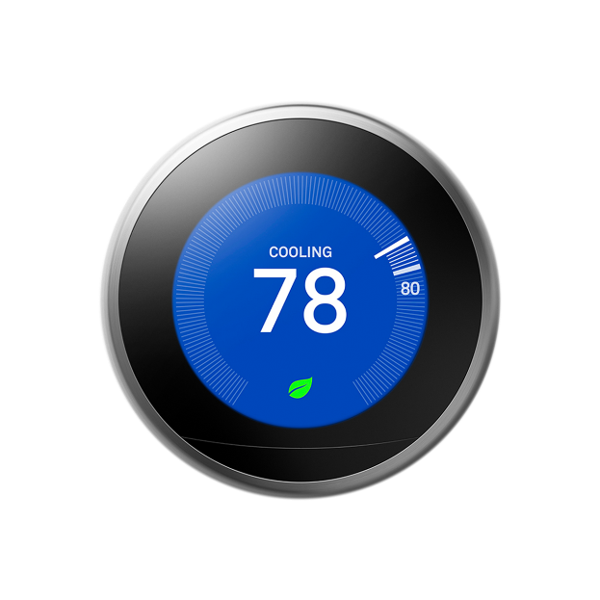
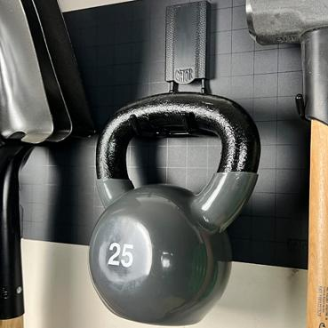
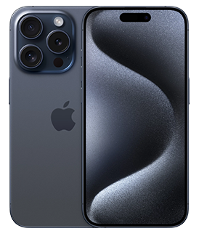
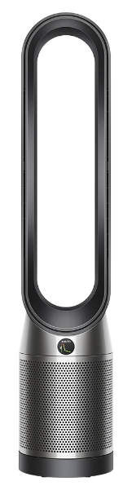
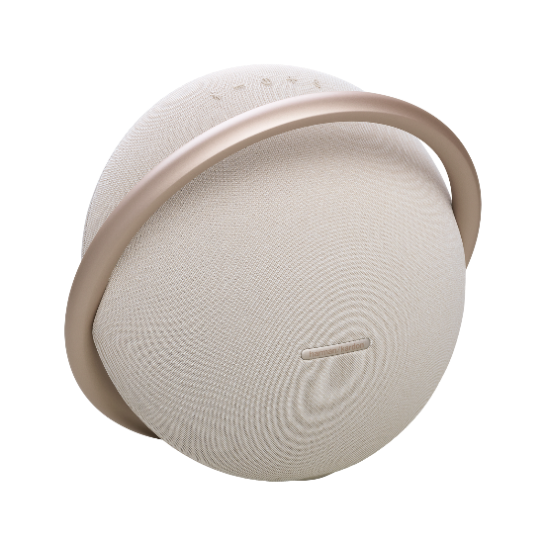
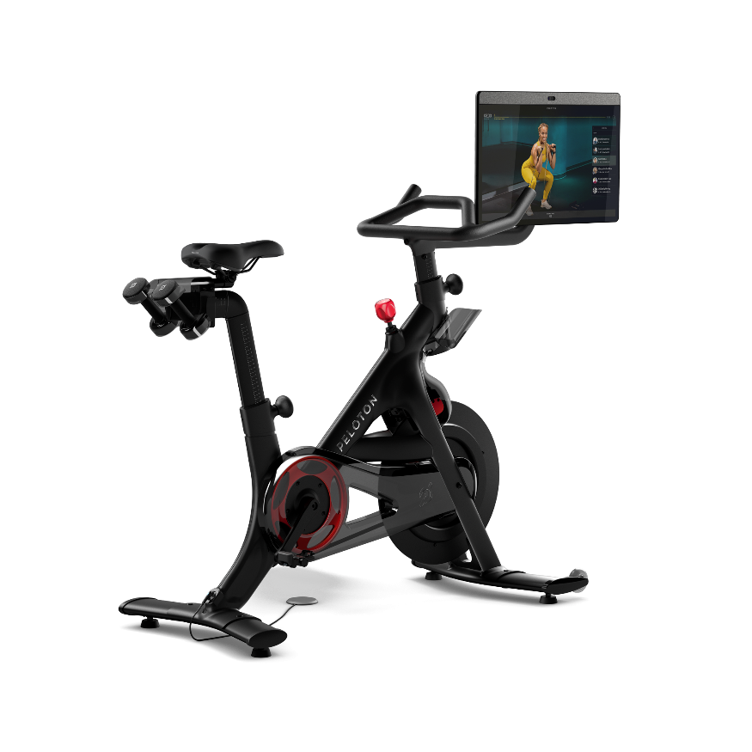
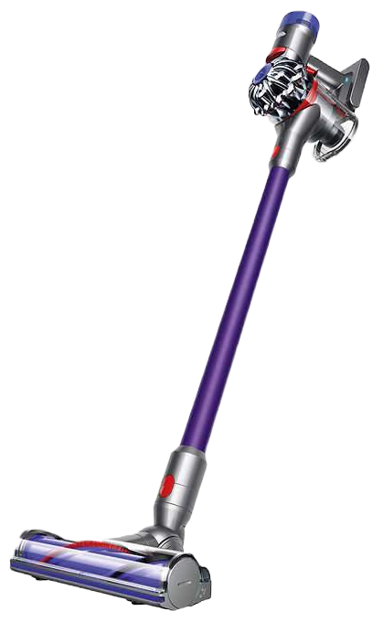
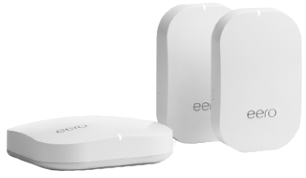
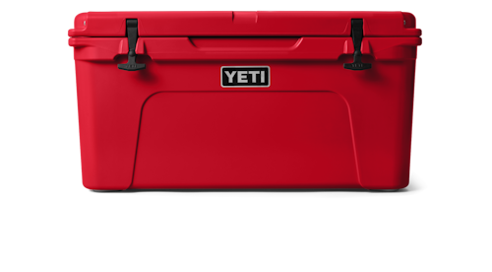
We Have Come to Expect Amazing Products
That Delight Our Senses
Notes:
We have come to expect products that delight the senses, and consumers are not getting less demanding. Magnetics should meet that bar too.

Slide 8

and consumers are not about to get less demanding
Notes:
Transition: consumers are not about to get less demanding. Set up the new-era claim.

Slide 9
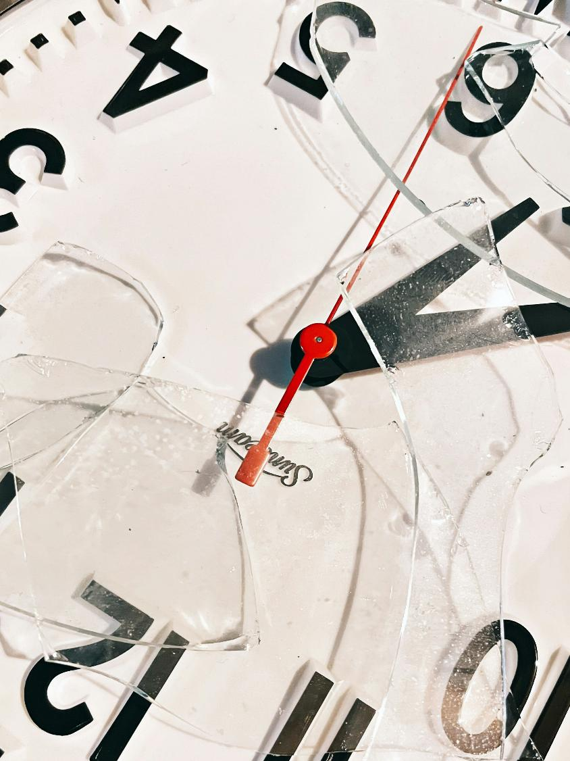

Enter the era of
Fast - Cheap - Perfection
®
CORRELATED MAGNETICS
Photo by Meghan Hessler on Unsplash
Notes:
Enter the era of fast, cheap, and perfection, not pick two. Time is money; the talk shows how we get all three.

Slide 10


DESIGN IN REAL TIME
Design advanced multi-pole magnets for your applications in less than a day
Create functions, level of haptic control and performance seemingly unachievable
Prototype your designs in less than an hour
Iterate the design the same day
Produce the final prototype in one day
….even iterate and prototype a new design during a customer visit!
All with the precision of the manufacturing process
At the cost of simply running the machine
TIME IS MONEY
Photo by Akram Huseyn on Unsplash
Notes:
10-minute version: about 40 seconds here; aim to be done by 1:45.
The thesis slide, say it slowly: design advanced multipole magnets in under a day, create functions and haptic control previously unachievable, prototype in under an hour, iterate the same day, final prototype in one day, even during a customer visit, all at manufacturing precision, at the cost of running the machine.

Slide 11
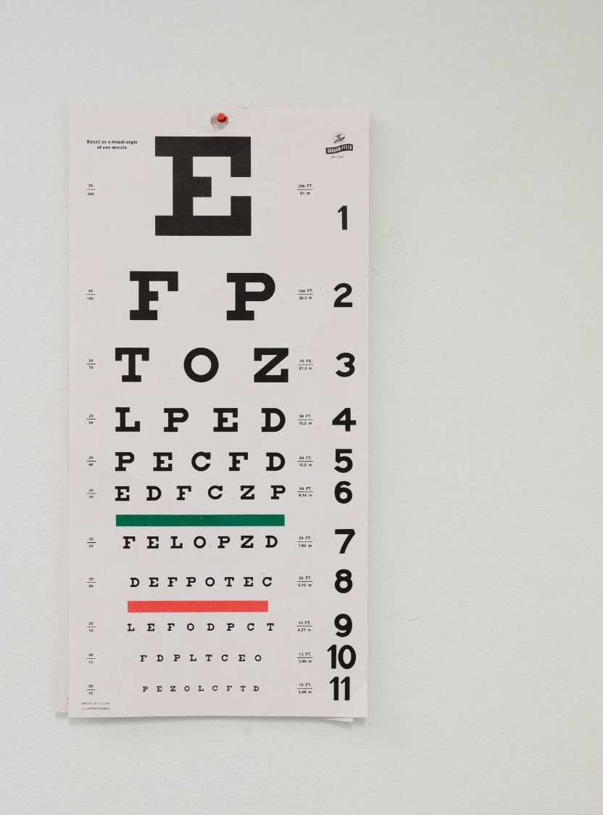
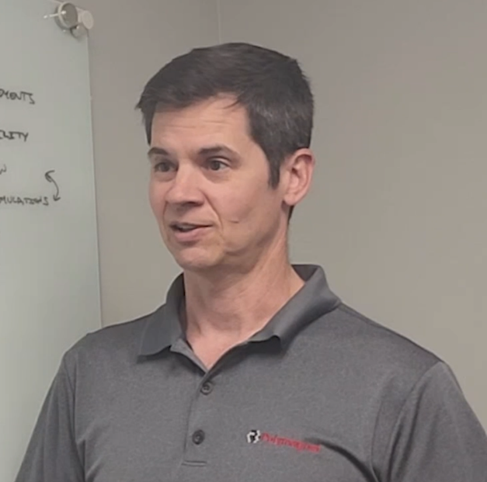
But Seeing is Believing,
So Lets Take a Journey Together
Meet Steve, he’s an engineer with a challenge
Steve needs to:
deliver a product concept in prototype form fast and he hasn’t even met with the customer yet!
Photo by Wesley Tingey on Unsplash
Notes:
10-minute version: about 25 seconds here; aim to be done by 2:10.
Seeing is believing, so take them on the journey. Meet Steve, an impatient engineer who must deliver a prototype fast and has not even met the customer yet. Everyone in the room knows Steve.

Slide 12
Steve is a busy designer; he likes to go fast and he is impatient. He needs to spend his design time efficiently, get to prototype quickly and iterate fast! Sound familiar?
Here’s his design process
  Requirements & Feasibility
  Specs
  Design
  Simulate, if applicable
  Prototype
  Test
  Clinic/CA
  Iterate if required
TIME IS MONEY
Photo by Akram Huseyn on Unsplash
Notes:
Steve's real design process: requirements, specs, design, simulate, prototype, test, clinic, iterate. Point to where weeks normally vanish, prototyping and iteration, which is exactly what we compress.

Slide 13


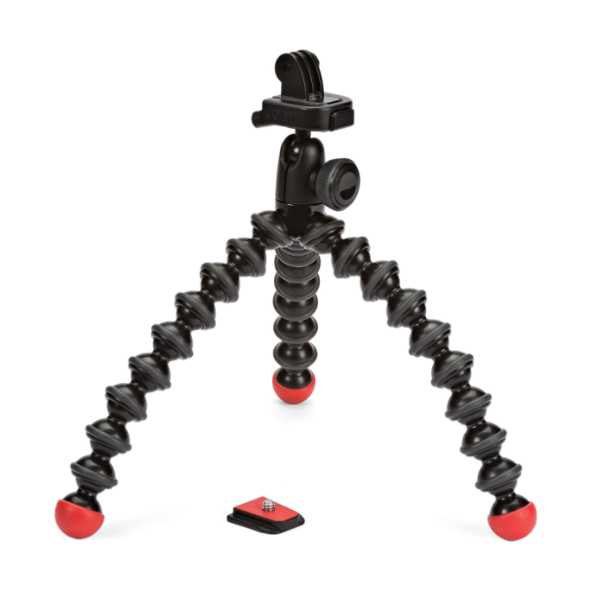
Initial Customer Meeting
Specs evolved out of this discussion
  An action camera tripod
  Designed for quick attach/detach
  With 20 detent indexing
  High attachment force (enough to hold a camera)
  Strong shear strength
  Concentric self alignment
  Less than 2 inch wide
  Minimize magnetic material
Notes:
10-minute version: about 35 seconds here; aim to be done by 2:45.
The initial customer meeting. Specs emerge live: an action-camera tripod mount, quick attach and detach, 20-detent indexing, high attachment force, strong shear strength, concentric self-alignment, under two inches wide, minimal magnetic material. Note how many are magnetization-pattern problems, not material problems.

Slide 14
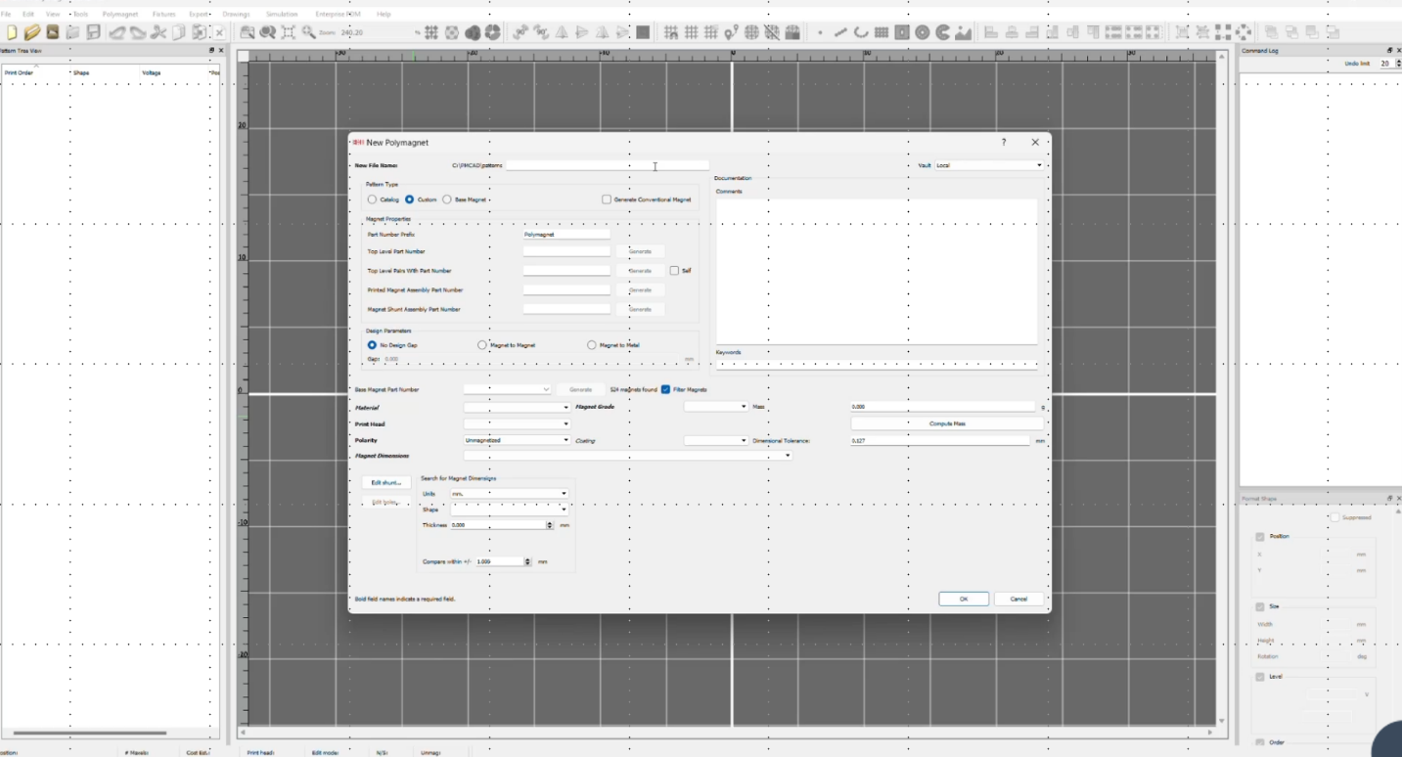
Steve jumps into design using PolyVision
®
®
CORRELATED MAGNETICS
Notes:
Steve jumps into design in PolyVision, our design environment, where the pattern of magnetized regions is authored.

Slide 15
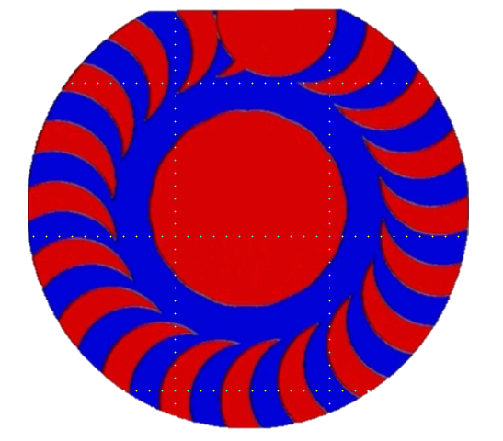
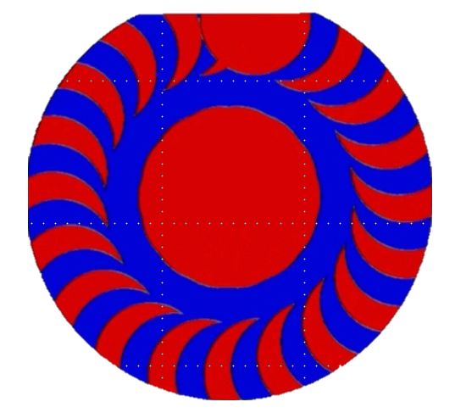
Step 1: PMCAD Design
Total design time: 5 minutes!
Complete design files for tray and magnetization
ANSYS integration ready
TIME IS MONEY
Up Next: Simulation or optional production tray printing
®
CORRELATED MAGNETICS
Notes:
10-minute version: about 35 seconds here; aim to be done by 3:20.
Step 1, PMCAD design: five minutes to a complete design with files for both the production tray and the magnetization, ANSYS-integration ready. Emphasize five minutes.

Slide 16
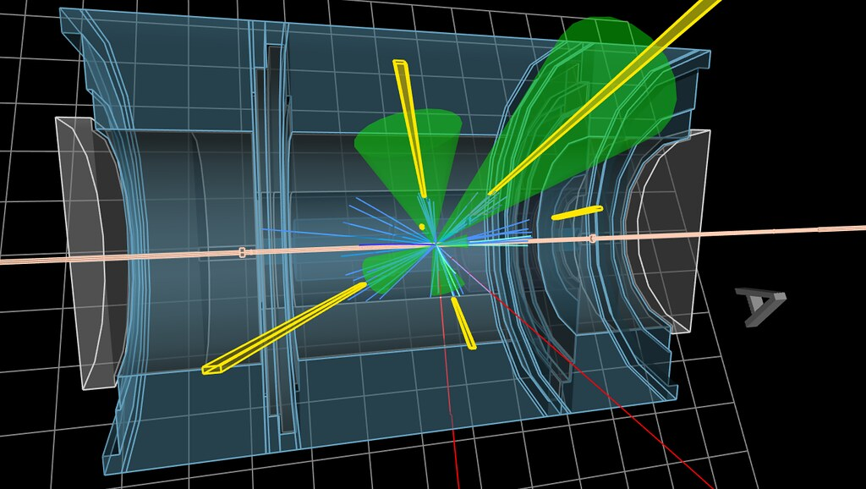
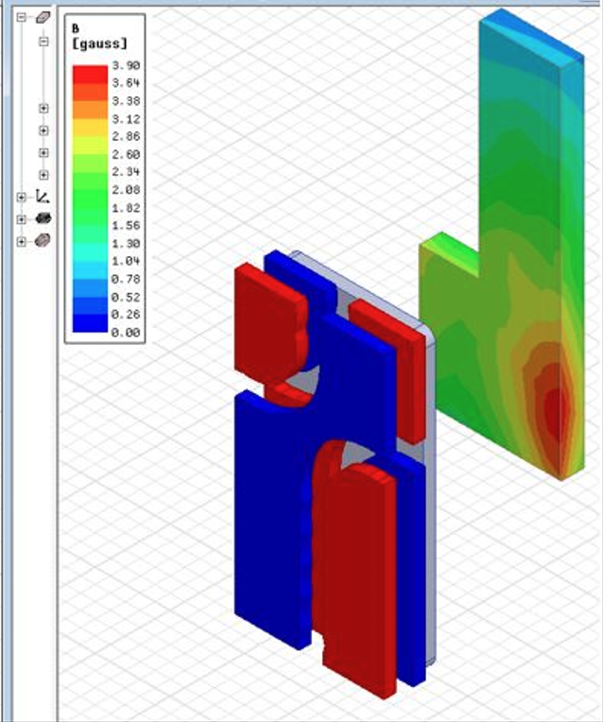
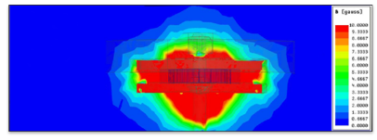
Simulation Phase
Ansys Maxwell / Electromagnetics Suite
Used prior to obtaining custom base magnets
Refine magnet geometry
Generate force diagrams
Optimize grade requirements
Test novel Polymagnet designs
®
CORRELATED MAGNETICS
Notes:
Optional simulation in ANSYS Maxwell before committing to custom base magnets: refine geometry, generate force diagrams, optimize grade, test novel designs. For this audience, stress that the workflow is simulation-coupled, not trial and error.

Slide 17
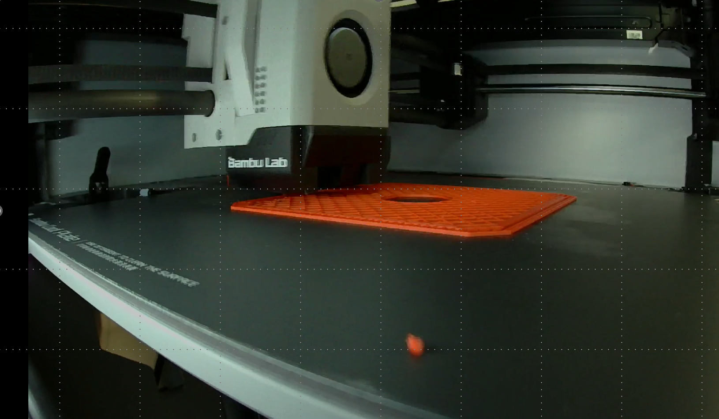
Make the production tray to hold the magnet
®
CORRELATED MAGNETICS
Notes:
Make the production tray that holds the magnet blank during magnetization, the fixture that registers the part to the magnetizing head.

Slide 18

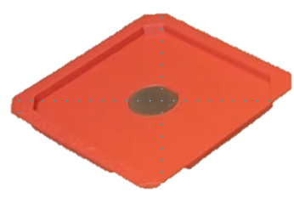
Armed with a Production Tray and a PMCAD Model, Steve is ready to make his Prototype Magnets
®
CORRELATED MAGNETICS
Notes:
With a production tray and a PMCAD model, Steve is ready to write the prototype magnets.

Slide 19
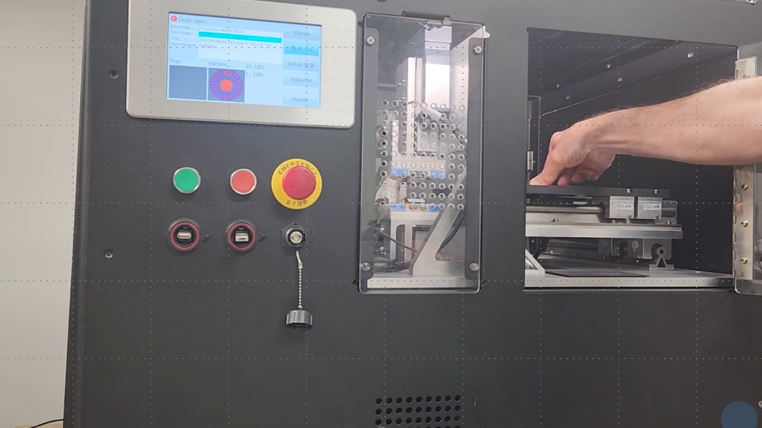
And now the magic begins…..
®
CORRELATED MAGNETICS
Notes:
10-minute version: about 40 seconds here; aim to be done by 4:00.
This is the magnetization step, where a blank becomes a programmed multipole magnet. The video was removed for the static deck, so narrate what is happening: the magnetizing head writing the pattern. The technical how is in the dedicated section later.

Slide 20
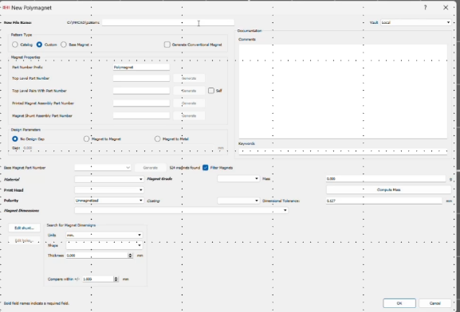
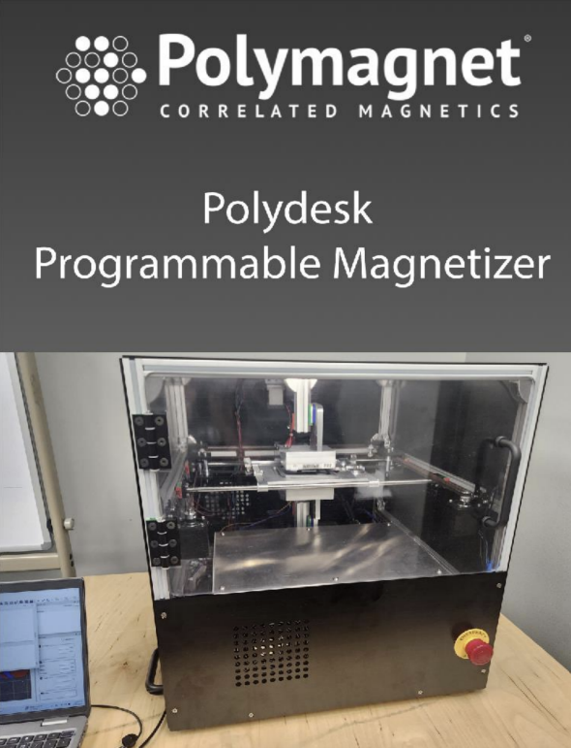
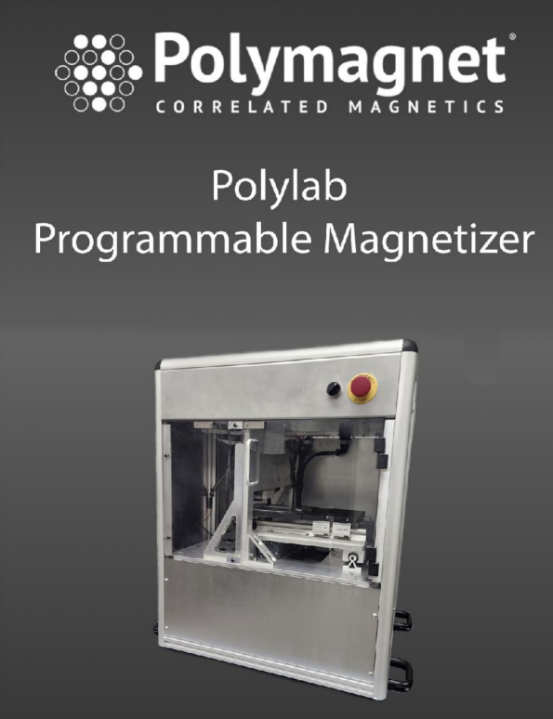
Stop Wasting Time & Money, Prototype multipole magnets in minutes…..
PolyVision®
Design Software
®
CORRELATED MAGNETICS
Notes:
Stop wasting time and money: prototype multipole magnets in minutes with PolyVision. Reinforce design-to-magnet speed.

Slide 21
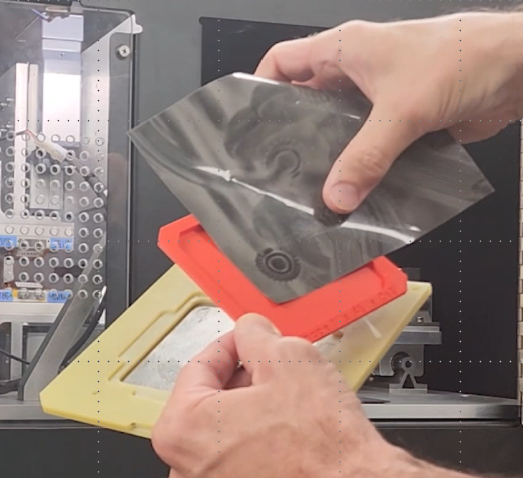
Step 2: Produce Prototype Magnets
Total design time: 5 minutes
3D Production Tray Printing 50 min (optional)
Magnetic Processing: 2 Minutes (12 seconds of process time)
Total Time to Prototype Magnet: 57 minutes!
®
CORRELATED MAGNETICS
Notes:
10-minute version: about 40 seconds here; aim to be done by 4:40.
Step 2, produce prototype magnets: 5 minutes design, 50 minutes optional tray printing, 2 minutes magnetization (12 seconds of actual process time), total 57 minutes to a prototype magnet. Let the 57 minutes land.

Slide 22

57 minutes in….
At this point we can ship our customer functional magnet pair or go one step further and ship a functional prototype
Let’s go for the gold!
®
CORRELATED MAGNETICS
Notes:
At 57 minutes we can already ship a functional magnet pair, or go further and ship a functional prototype. Go for the gold.

Slide 23
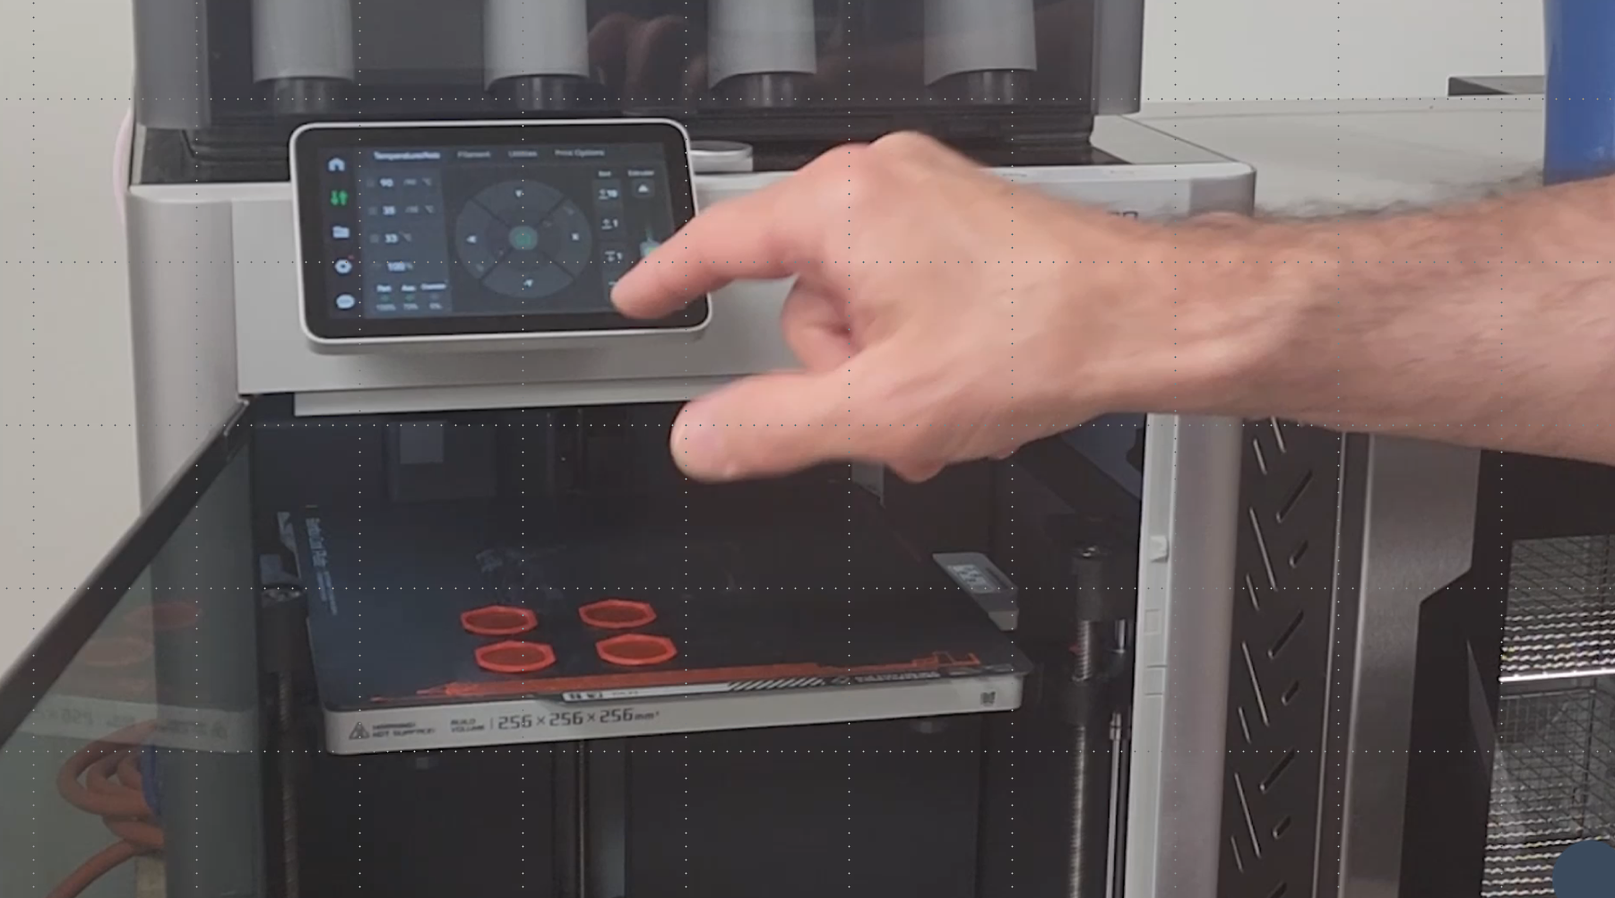
Printing a functional prototype
®
CORRELATED MAGNETICS
Notes:
Printing the functional prototype around the magnets. Video removed, so narrate the print: we are assembling a working device, not just a magnet.

Slide 24
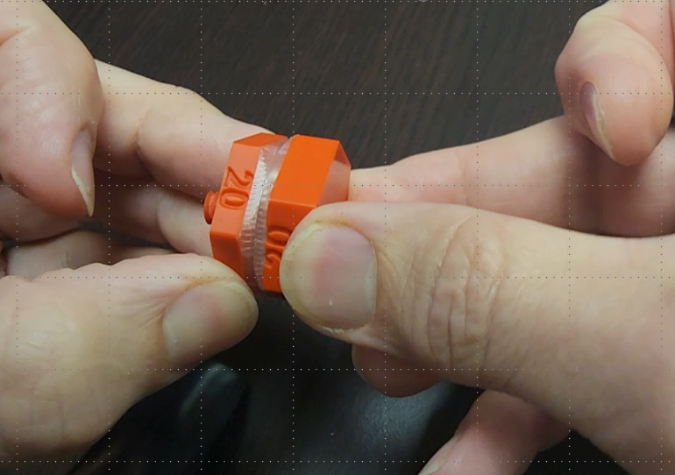
In less than 2 hours……a working prototype!
…..ready for customer feedback
®
CORRELATED MAGNETICS
Notes:
In under two hours: a working prototype, ready for customer feedback. This is the headline number of the demo.

Slide 25
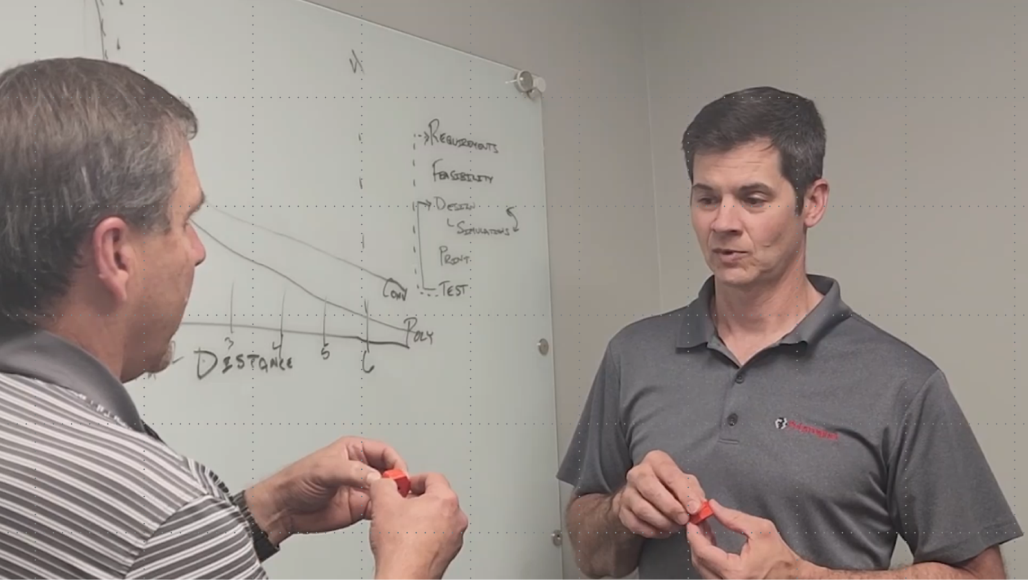
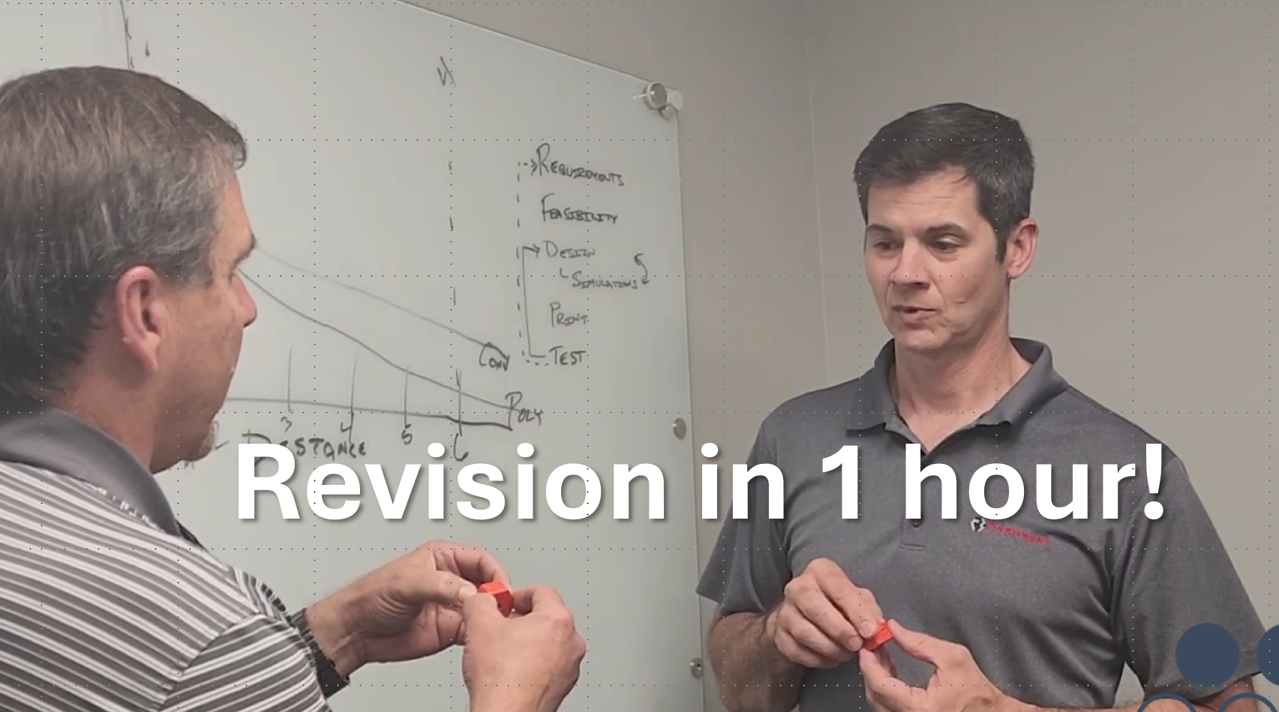
2 hours in: Steve is ready for a customer review
Revision in 1 hour!
®
CORRELATED MAGNETICS
Notes:
Two hours in, Steve is ready for a customer review, and can turn a requested revision in under an hour. The agility claim made concrete.

Slide 26
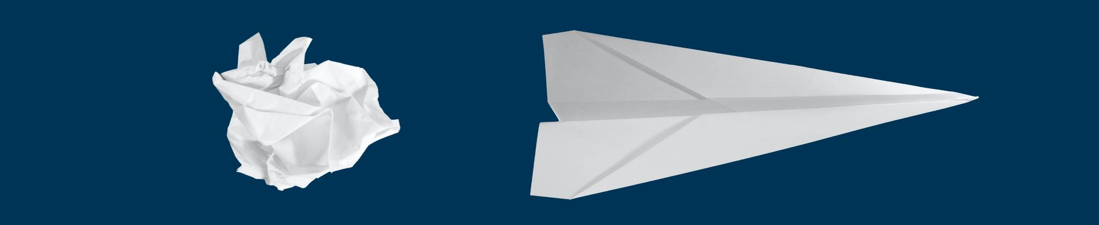
Engagement Review:
Customer Meeting & Specification Development
PMCAD design 5 minutes
Production tray printing (if needed) 50 minutes
Custom magnetization 2 minutes
Prototype production less than an hour
Customer requested change, less than an hour!
In Summary:
In less than half a day, we went from the initial customer meeting, to a functional prototype, to an optimized design & final prototype
®
CORRELATED MAGNETICS
Notes:
10-minute version: about 45 seconds here; aim to be done by 5:25.
Engagement review, the whole loop on one slide: meeting and spec, PMCAD design 5 min, tray printing 50 min, magnetization 2 min, prototype under an hour, customer-requested change under an hour. In less than half a day: initial meeting to functional prototype to optimized final design. Pause; this is the emotional peak before the technical depth.

Slide 27
The technology behind the speed
How agile magnetization works, what it can do, and where it is going.
Notes:
Transition from the demo to the engineering. You have seen the speed; here is the magnetics underneath it. Three slides: how maxels are written, the operating window, and the frontiers it opens.

Slide 28
How it works: writing maxels
A Polymagnet is a standard permanent magnet programmed with many small magnetized regions. Each region is a maxel, a magnetic pixel with its own polarity and strength.
A magnetizing head writes each maxel into the blank with a localized capacitor-discharge pulse, the magnetic equivalent of a dot-matrix printer. Write strength is set by the charge voltage, and overlapping maxels raise the pattern resolution.
Tens to hundreds of maxels, arranged by design, form a magnetic circuit that defines the function. The behavior comes from the pattern, not from the material.
This is the magnetic-processing step in Steve's demo: about twelve seconds of process time turns a blank into a programmed multipole magnet.
CORRELATED MAGNETICS
Notes:
10-minute version: about 50 seconds here; aim to be done by 6:15.
Define a maxel: a printed magnetic pixel, a dipole with positive and negative poles, written by a magnetizing print head (US Patent 9,105,384 B2). Lean on the printing analogy. The key engineering point for this room: the function is encoded in the spatial pattern of maxels, so one material and one process yield many behaviors. Ties directly to the twelve-second magnetization step the audience just saw.

Slide 29
The operating window
Programmable on standard magnet materials: ferrite, neodymium, samarium-cobalt, and flexible magnet stock.
Published maxel sizes run from roughly one to four millimeters, with tens to hundreds of maxels per magnet, fine enough to encode alignment, latch, spring, and detent behavior.
Because the field is shaped by the surface pattern, force is concentrated near the face and falls off faster than a conventional magnet of the same material: stronger where you want it, quieter where you do not.
Simulation-coupled: geometry and force are refined in ANSYS Maxwell before a design is committed, as in Steve's workflow.
CORRELATED MAGNETICS
Notes:
10-minute version: about 45 seconds here; aim to be done by 7:00.
Give the ranges as published figures (maxel size about 1 to 4 mm; tens to hundreds per magnet). The faster near-field falloff is a genuine property of short-wavelength surface patterns: higher spatial frequency decays faster with distance. Keep force claims qualitative here; if the room asks for exact pole pitch, field strength, or material grade, answer from your current spec sheet rather than this slide.

Slide 30
Magnetic-circuit optimization
The function lives in the code. Polarity patterns are designed with correlation theory borrowed from radio-frequency signal design, the correlated in correlated magnetics, so a magnet pair can be made to align, latch, spring, hold torque, or resist shear on demand.
Because designing, printing, and testing a pattern takes minutes, the design space can be explored with real parts, not simulation alone.
Contactless torque couplings transfer force across an air gap with overload protection and no wear, a circuit you cannot build by assembling discrete magnets.
The agile loop turns magnetic-circuit design from a fixtured, weeks-long exercise into same-day optimization.
CORRELATED MAGNETICS
Notes:
10-minute version: about 45 seconds here; aim to be done by 7:45.
This is the intellectually strongest slide for an IEEE audience: the coding lineage from RF signal-correlation theory is the origin of the name correlated magnetics and of the tunable force-versus-distance behavior. Emphasize empirical design-space exploration with real parts, enabled by the minutes-long loop. The contactless coupling is a concrete circuit impossible with discrete magnets.

Slide 31
New frontiers
Geometries that fixtured magnetization cannot reach: net-shape and injection-molded magnets, and patterns on non-flat surfaces.
Fully customizable magnetic sensors built from programmed patterns.
Contactless, frictionless gears and couplings, already drawing defense interest.
Designing for rare-earth reduction: more function from less material as neodymium supply tightens.
CORRELATED MAGNETICS
Notes:
10-minute version: about 45 seconds here; aim to be done by 8:30.
Frame these as open engineering frontiers, which an IEEE research audience will appreciate. Net-shape and injection-molded magnets extend the geometry envelope; customizable sensors and contactless gears are active directions; rare-earth reduction is both a design goal and a supply-chain hedge. Then hand to the booth close.

Slide 32


CORRELATED MAGNETICS
Booth 11
Go see for yourself,
after all, seeing is believing!
and TIME IS MONEY
Photo by Abbat on Unsplash
Notes:
10-minute version: about 25 seconds here; aim to be done by 8:55.
Go see it for yourself: seeing is believing, and time is money. Point to Booth 11.

Slide 33




Tim Costello
Chairman & Chief Executive
www.polymagnet.com
tim@polymagnet.com
512 413 6983
@bylinetim
Notes:
10-minute version: about 15 seconds here; aim to be done by 9:10.
Close and contact. Invite questions and a booth visit.

